Slide 1
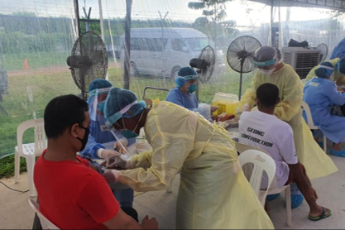
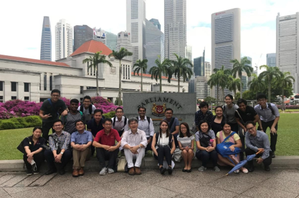
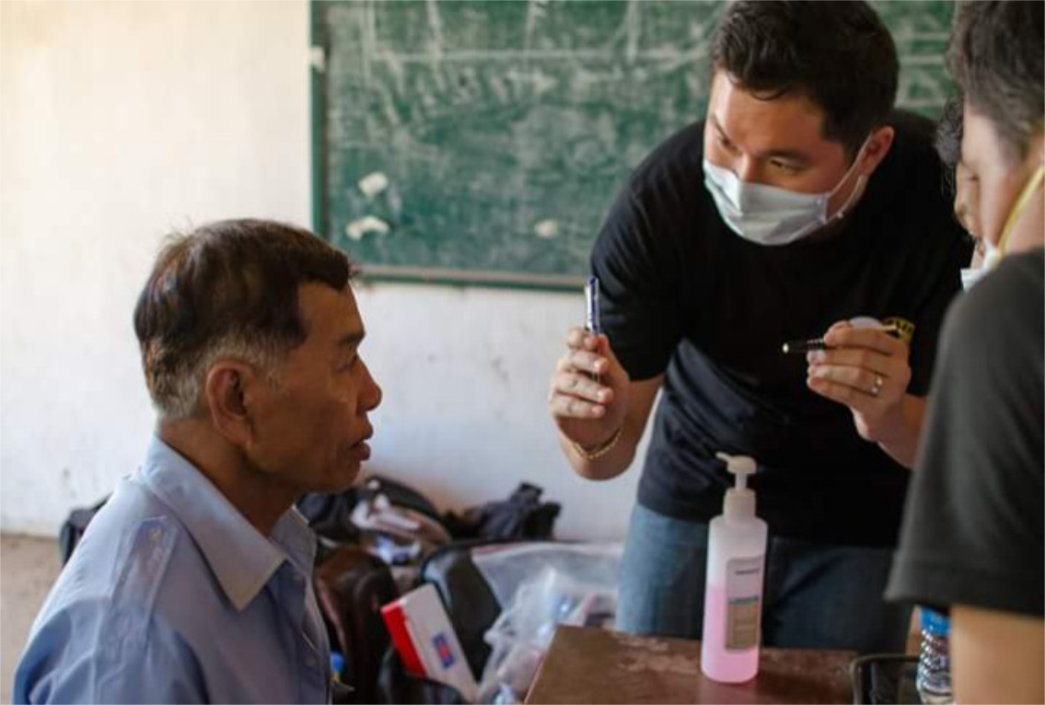
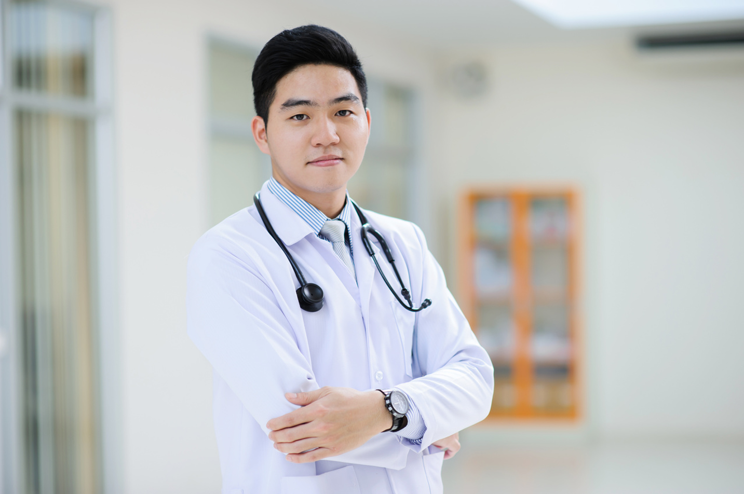
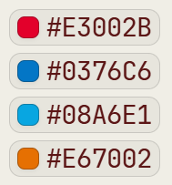
#E3002B
#0376C6
#08A6E1
#E67002

Slide 2


Slide 3
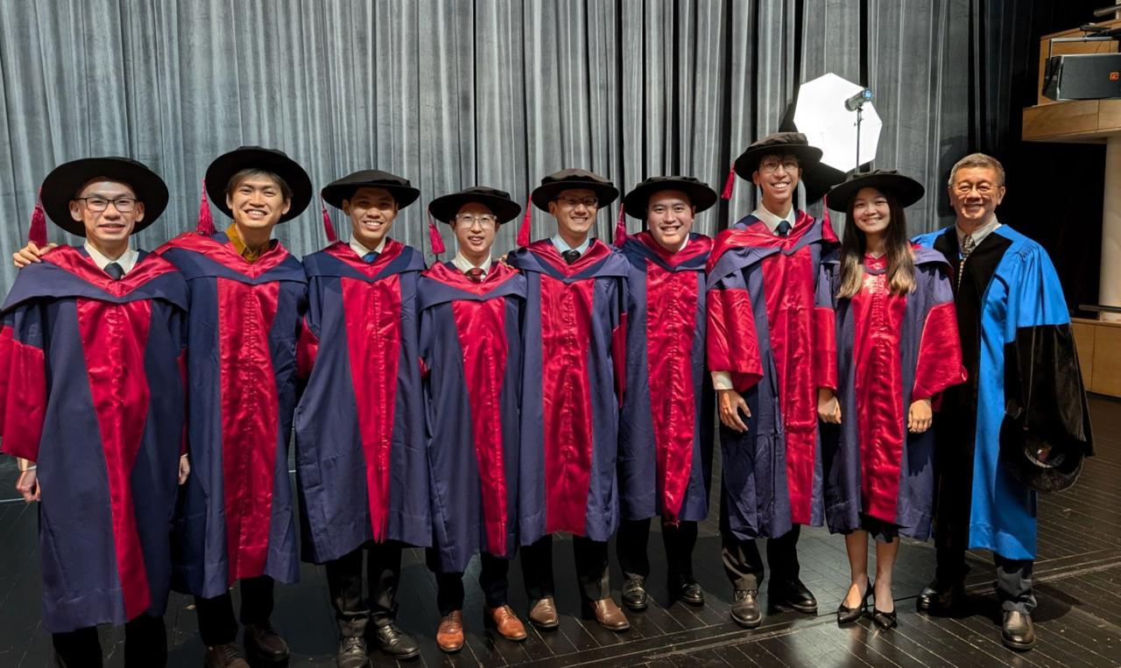
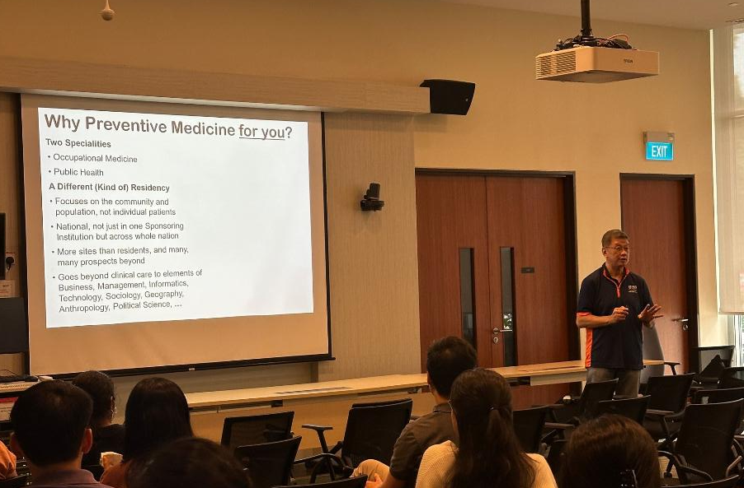

Slide 4


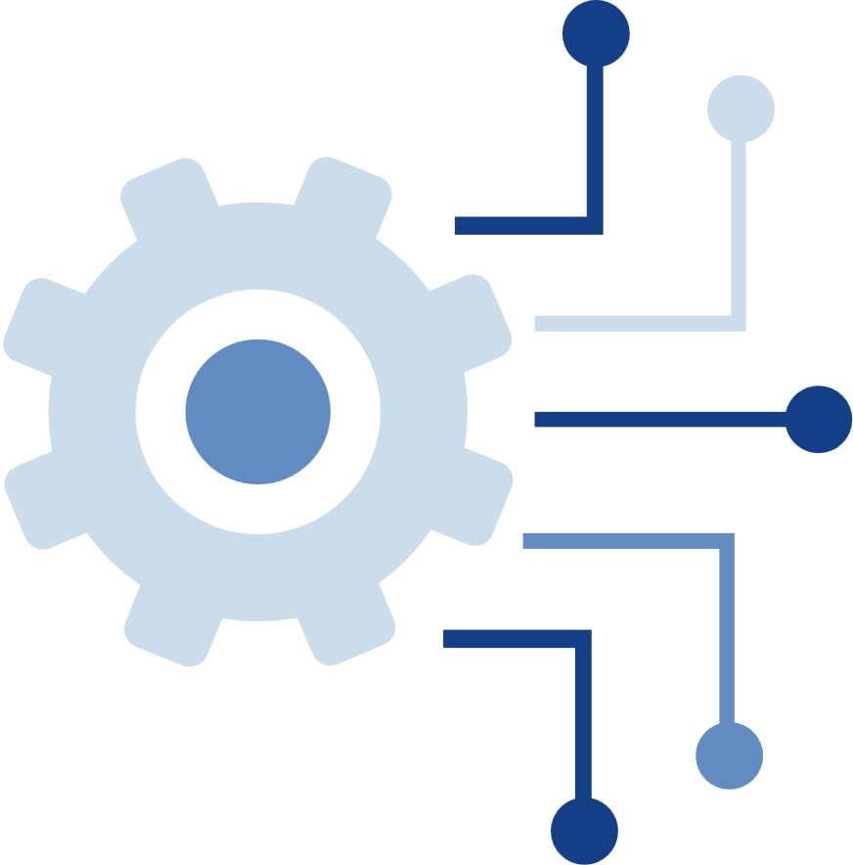

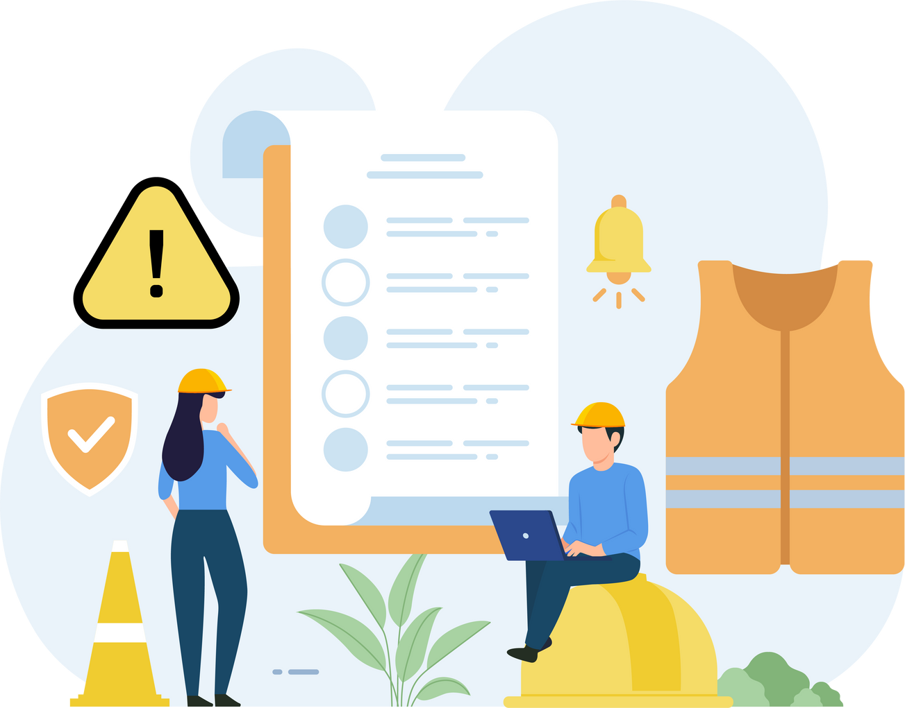
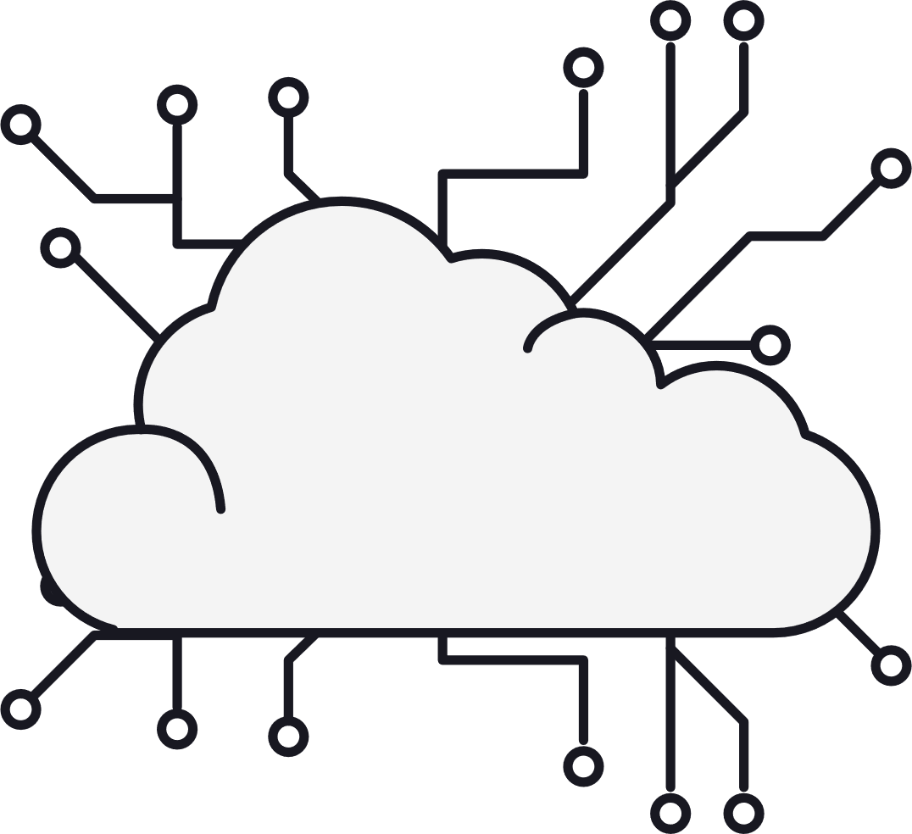
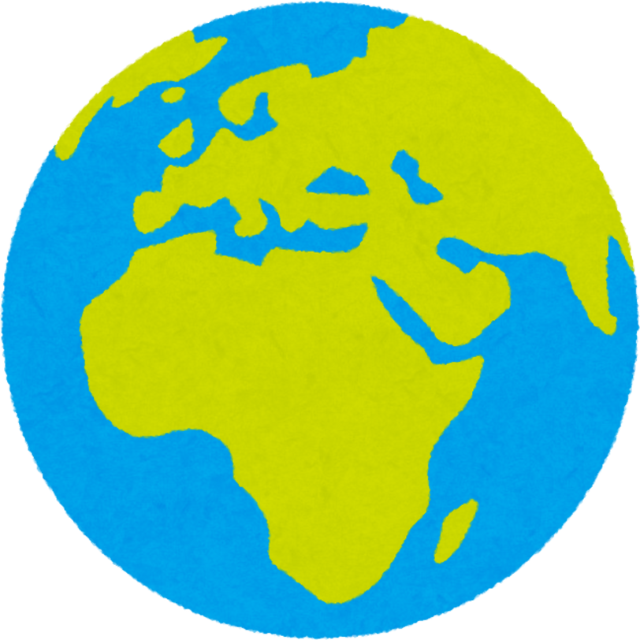

Slide 5

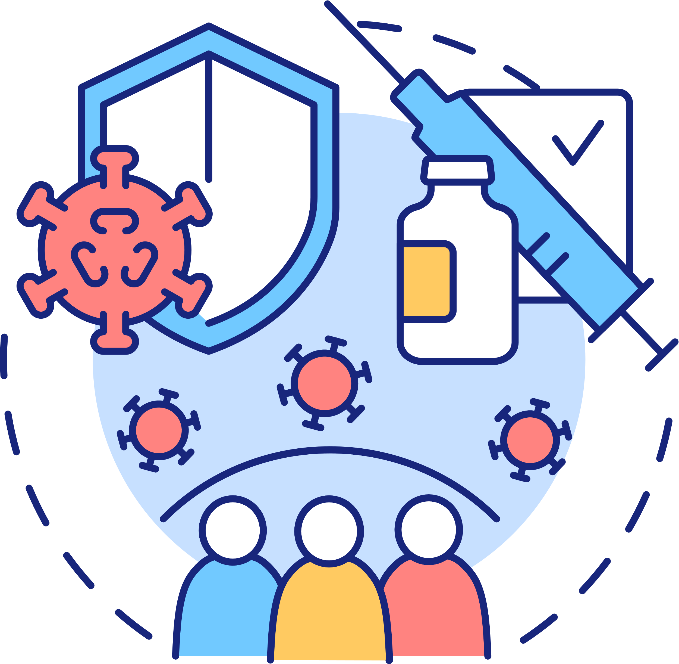
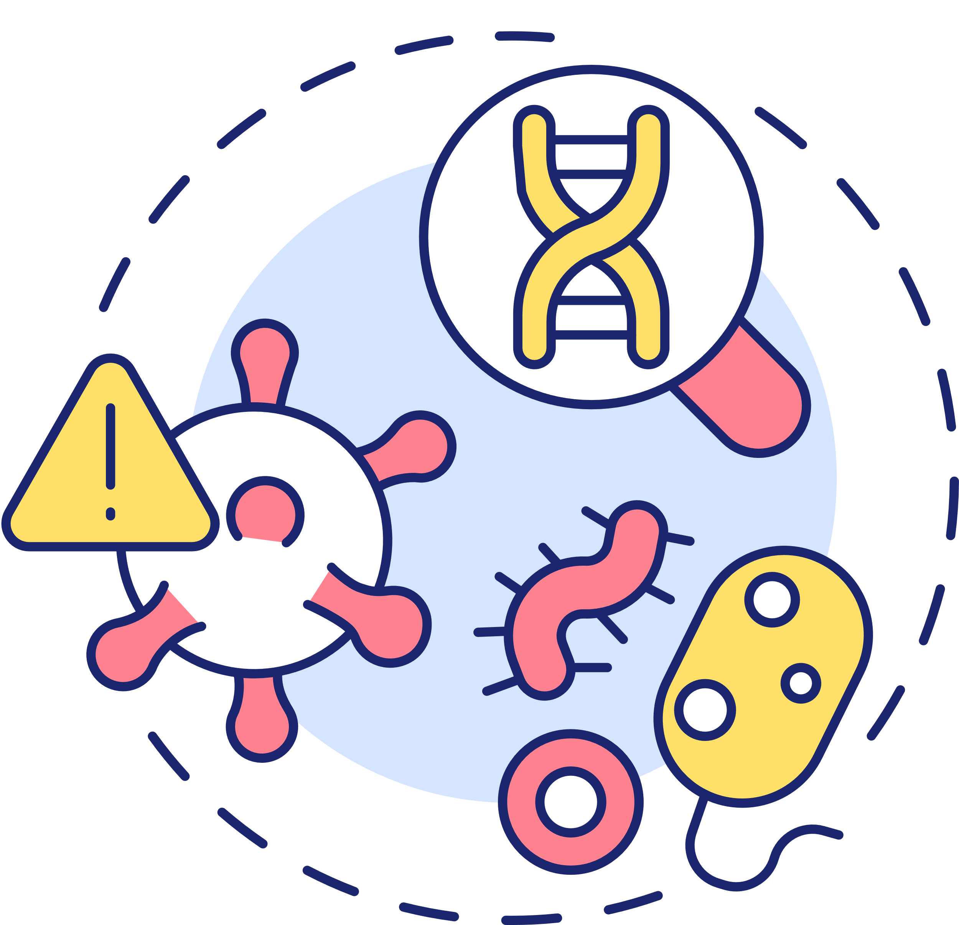

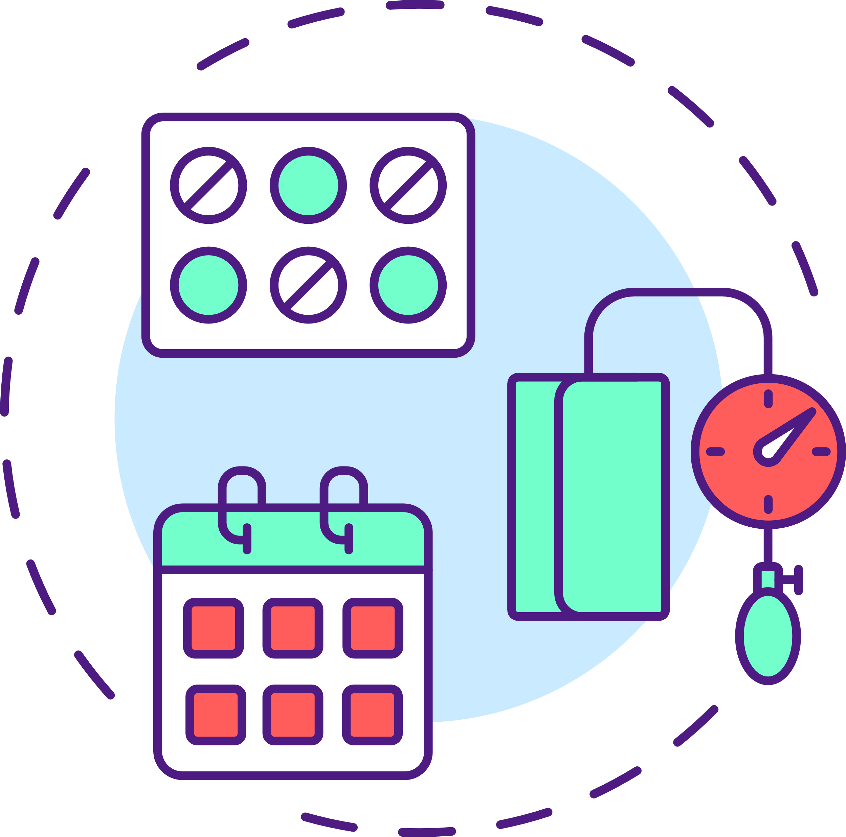

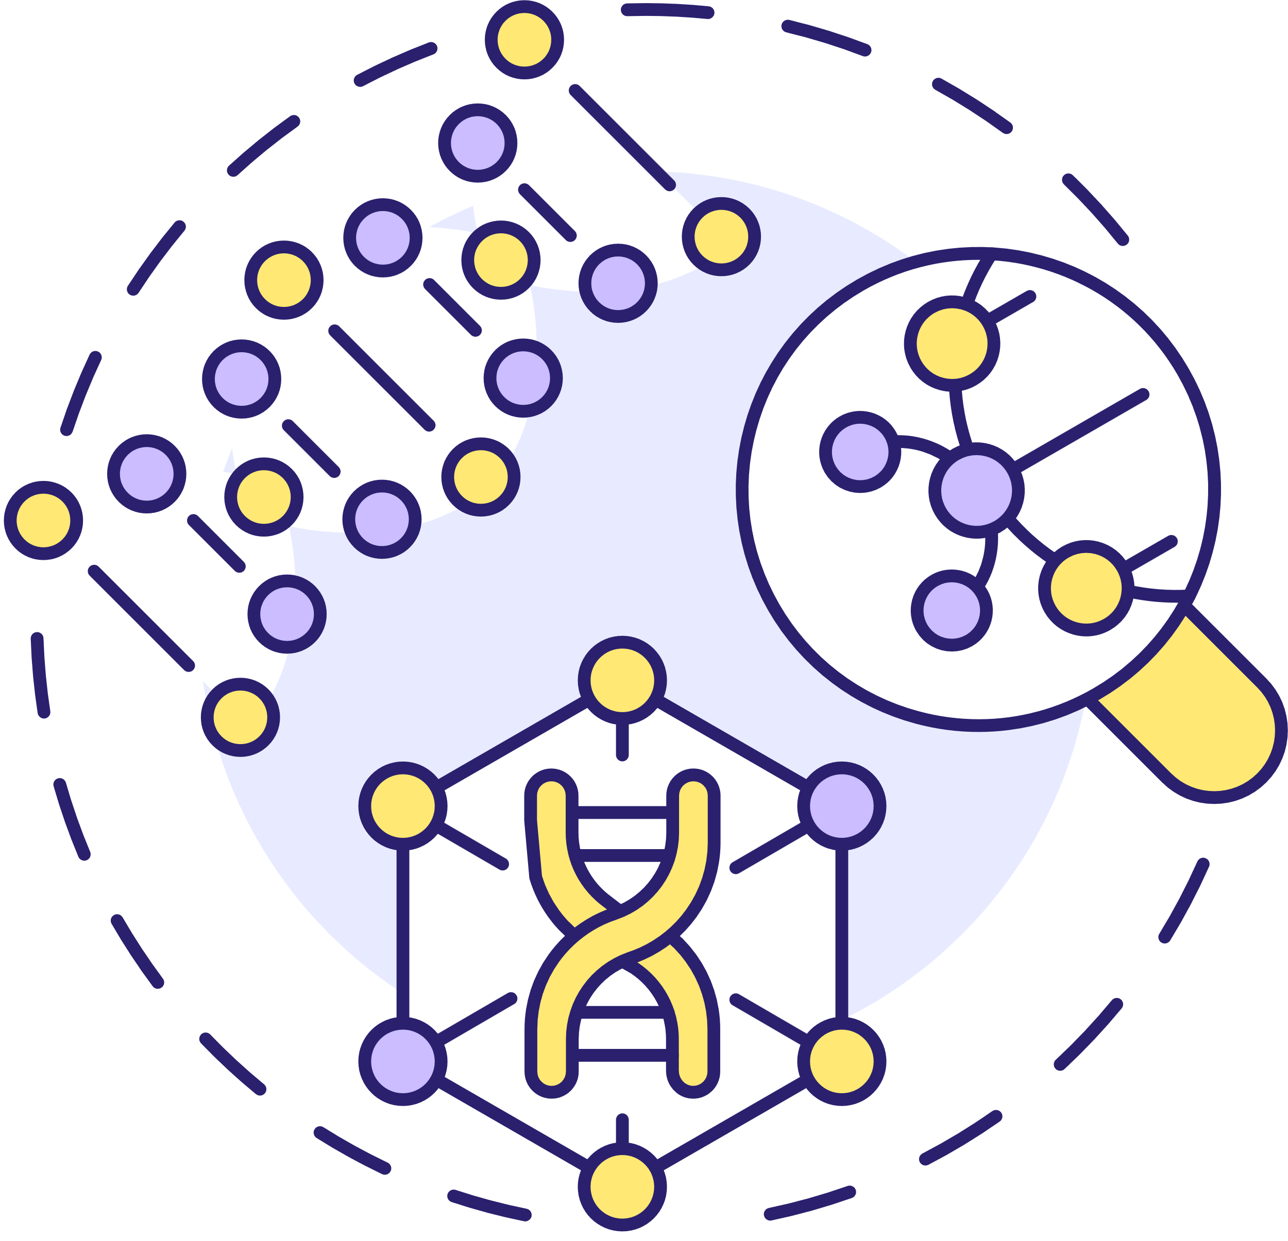
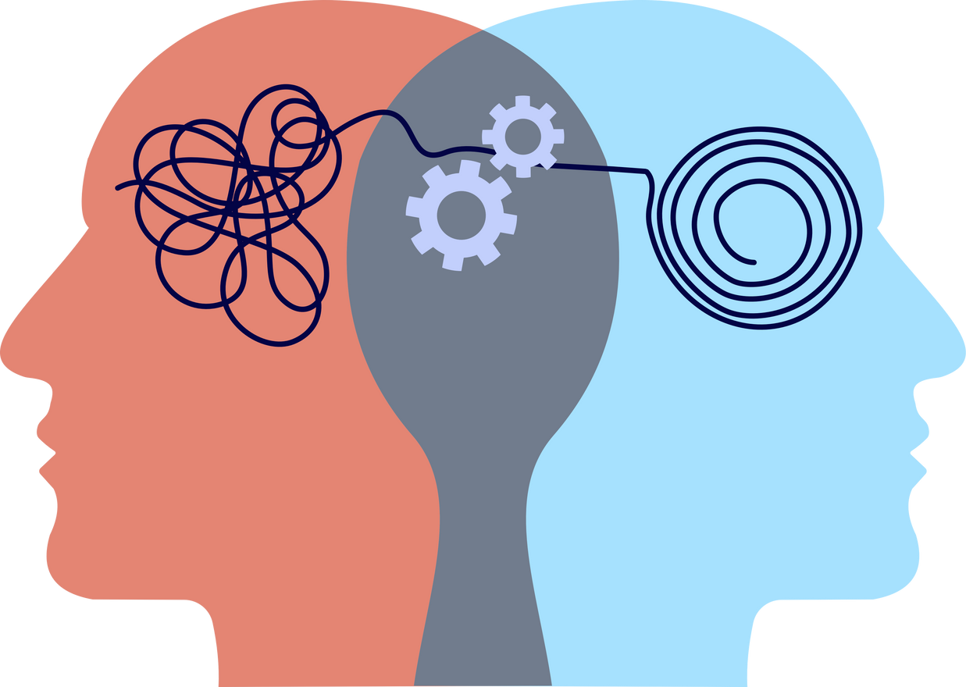

Slide 6
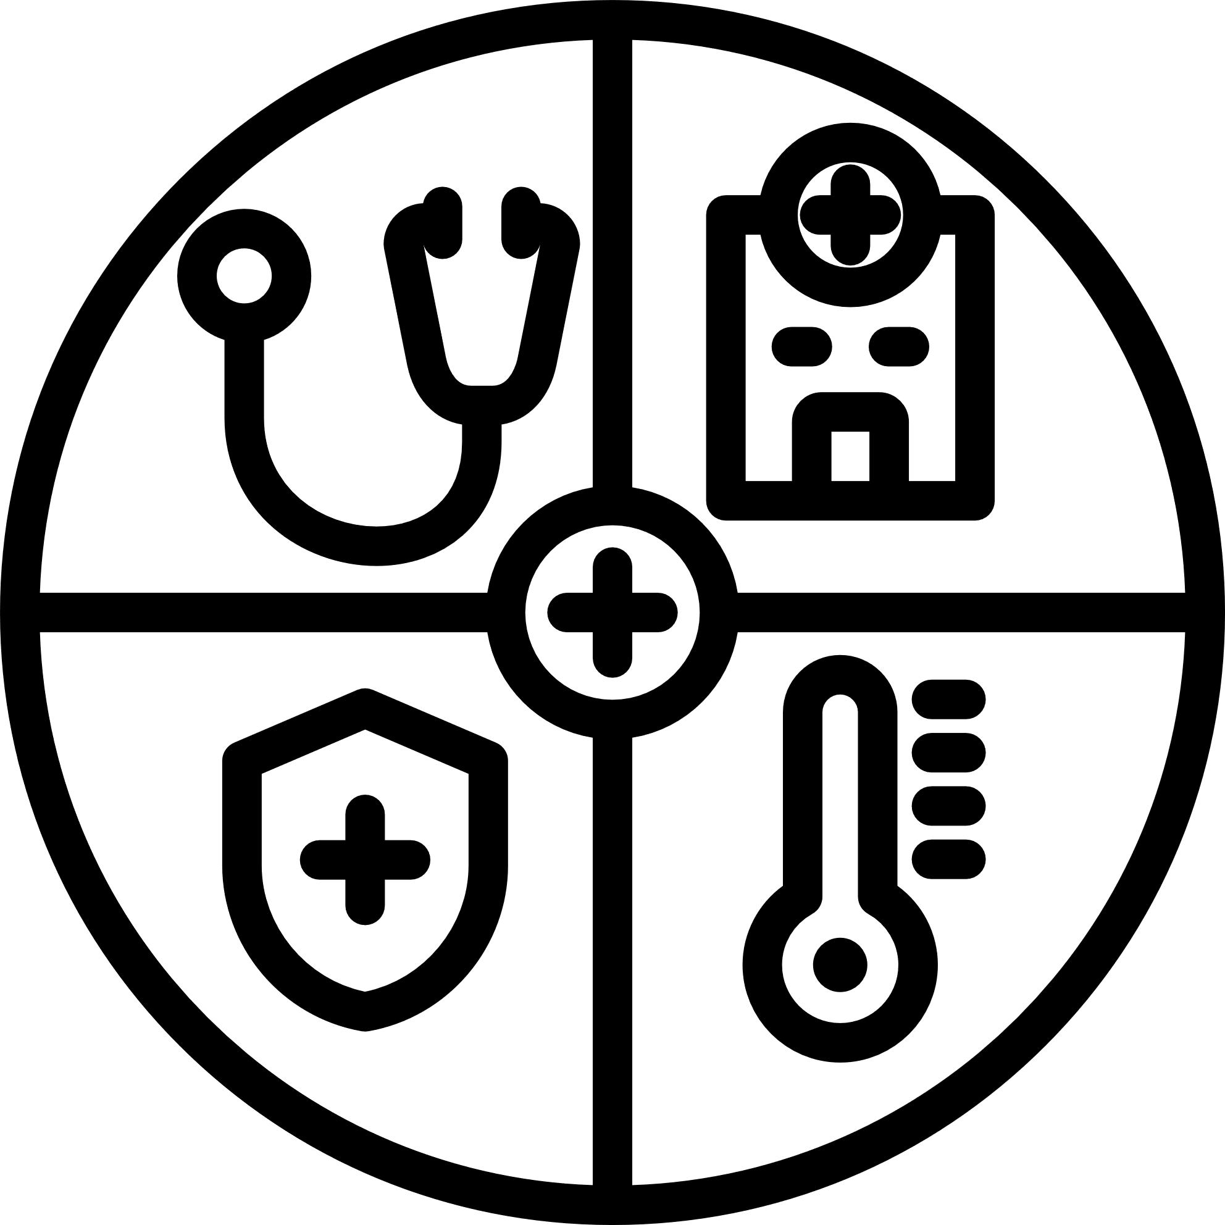




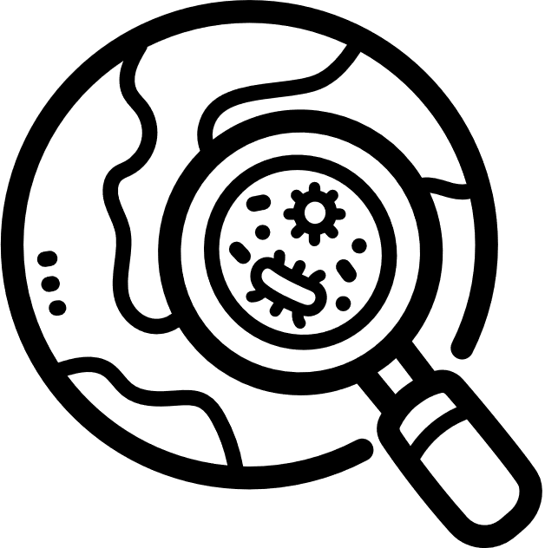

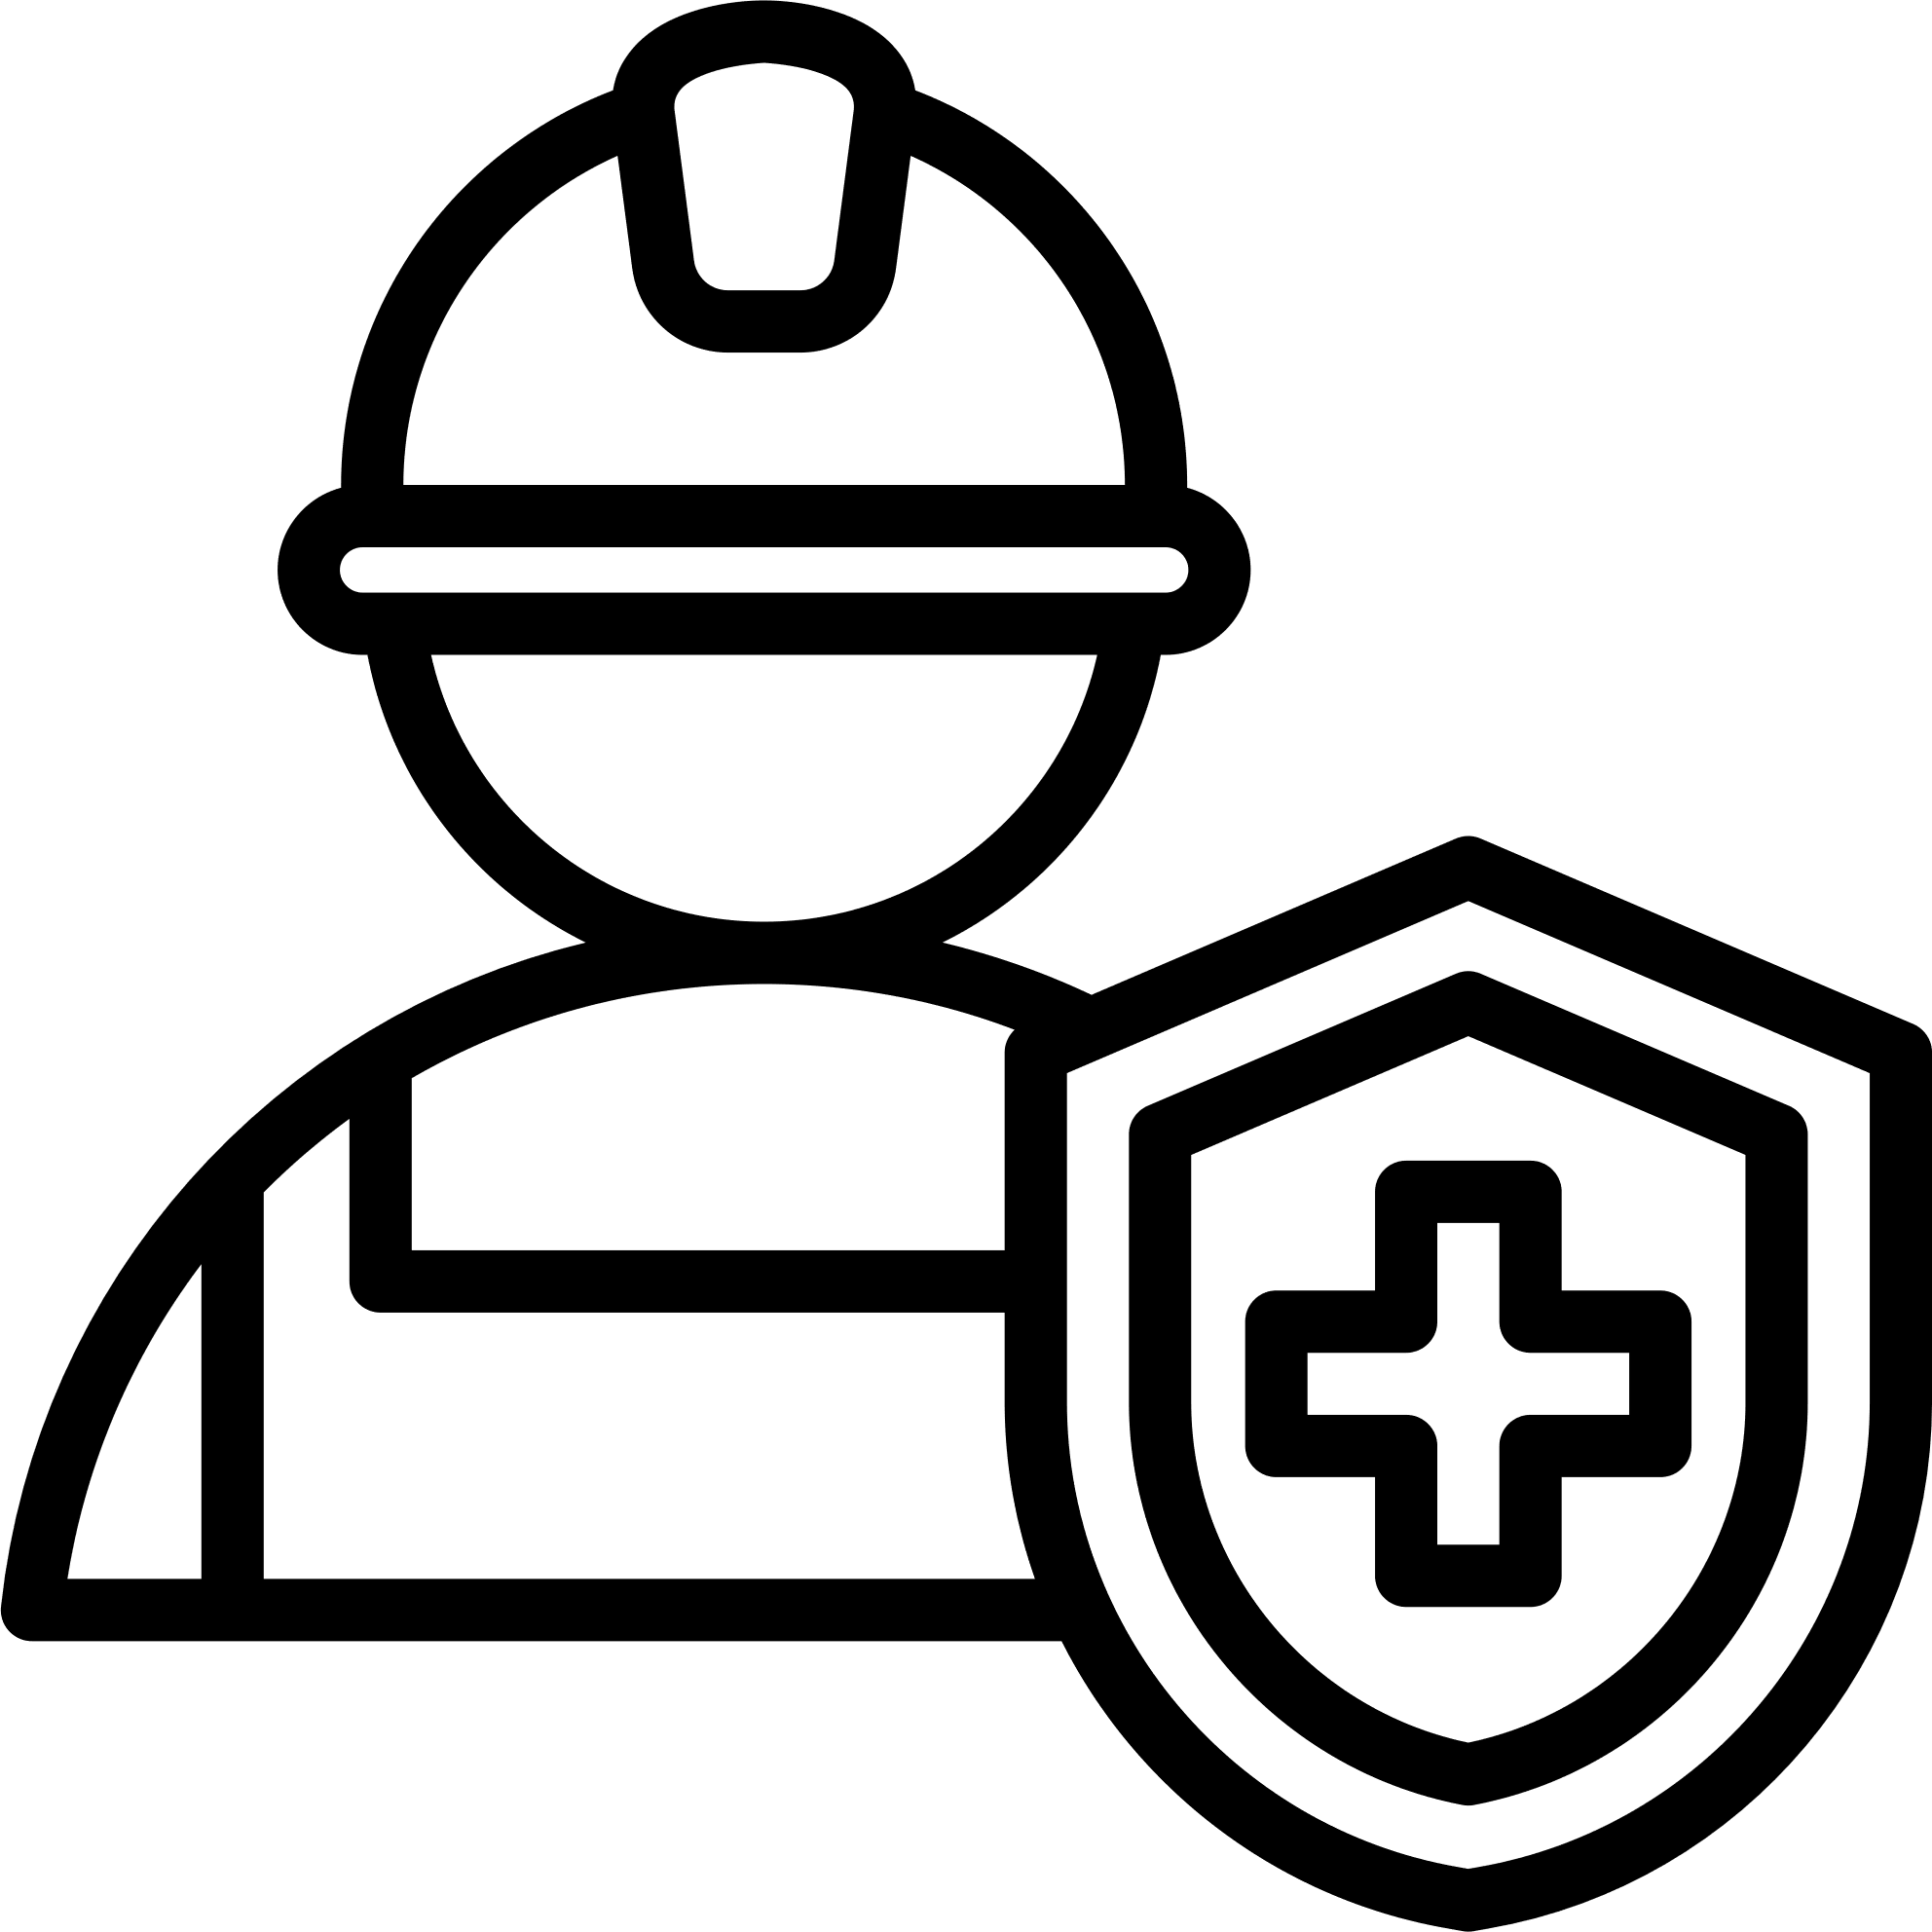

Slide 7
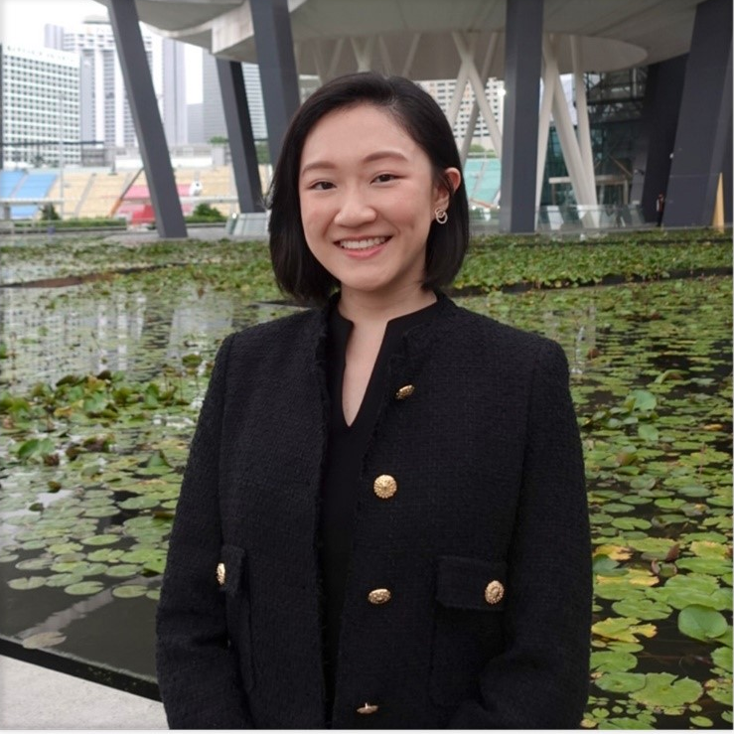
Dr Leonora Liu, National Preventive Medicine Residency Programme, 2018 cohort
"I chose to join the National Preventive Medicine Residency (NPMR) Programme as I wanted to work at the systems level, to effect change that would benefit the health of communities and populations. To me, health goes beyond healthcare. Equally as important as the medical treatment of the sick are the preventative efforts to address the biological, social and environmental determinants of health.
Through a mandatory Master of Public Health (MPH) in junior residency, NPMR residents acquire essential knowledge in epidemiology, biostatistics and health behaviour change, among other areas. My rotations through public healthcare clusters and public health agencies (e.g. Ministry of Health) have allowed me to leverage on my experience in clinical medicine and apply public health principles learnt during my MPH to shape and operationalise healthcare policies.
By working with a wide range of stakeholders including senior management, policy-makers, clinicians and researchers, the programme has also given me myriad opportunities to hone my collaboration and communication skills. For example, during my time in the Ministry of Health, I facilitated discussions between politicians, clinicians and representatives from the Ministry of Social and Family Development, to develop pilot programmes integrating upstream and downstream health and social care for Persons with Disabilities.
Part of what makes Preventive Medicine (i.e. Public Health and Occupational Medicine) exciting to me is how broad the field is. Since rotations are tailored to each individual resident's interests, this translates into a heterogeneity of experiences among residents. This diversity among residents creates an environment that promotes an interdisciplinary approach to learning and problem-solving, and has trained me to consider each public health issue from different perspectives."

Slide 8
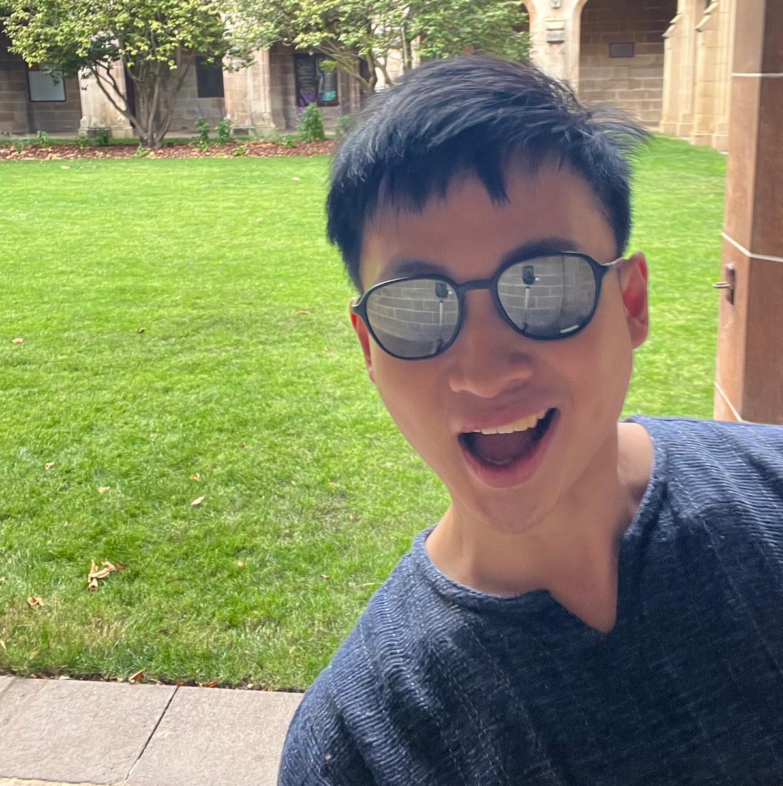
"I chose Preventive Medicine because I want to impact health beyond individual patient encounters—focusing on populations and communities instead. The diversity of public health and occupational medicine is one of the most appealing aspects of this field. As I begin this program, I'm already seeing opportunities that exist well outside the traditional hospital setting, from workplace health assessments and environmental monitoring to policy development and community health programs.
The curriculum ahead covers epidemiology, biostatistics, health policy, and health promotion across various real-world applications. I'm looking forward to gaining experience in corporate settings, government agencies, research environments, and community organizations—each offering different perspectives on how to improve population health.Early in the program, I'm already working with management teams, policymakers, clinicians, and researchers, which is improving my ability to communicate across different professional contexts. The collaborative nature of this work is both challenging and engaging as we tackle the complex factors that influence health outcomes.I'm excited about the variety of roles available in preventive medicine and feel this program is setting me up well to address public health challenges in whatever setting I eventually choose. For anyone interested in population health, this program provides solid training and exposes you to career paths you probably haven't considered. The field offers more options than most people realize."

Slide 10
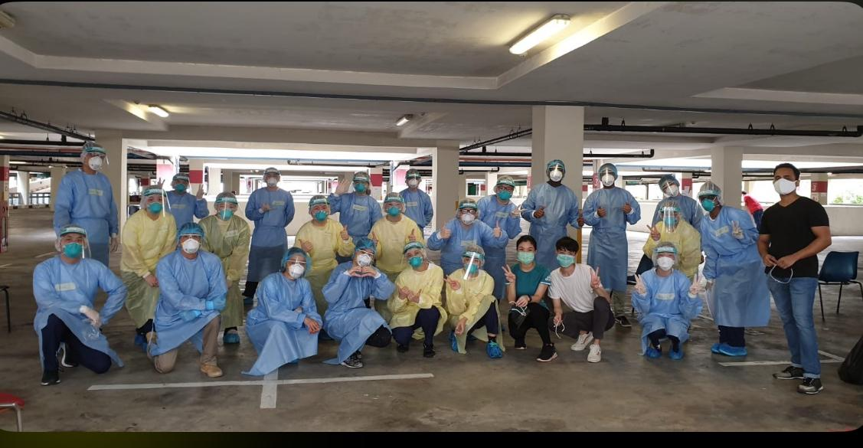

Slide 11
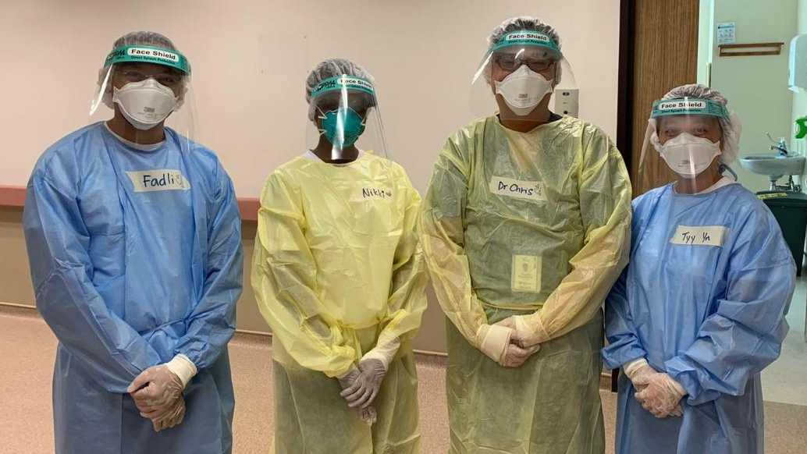

Slide 12
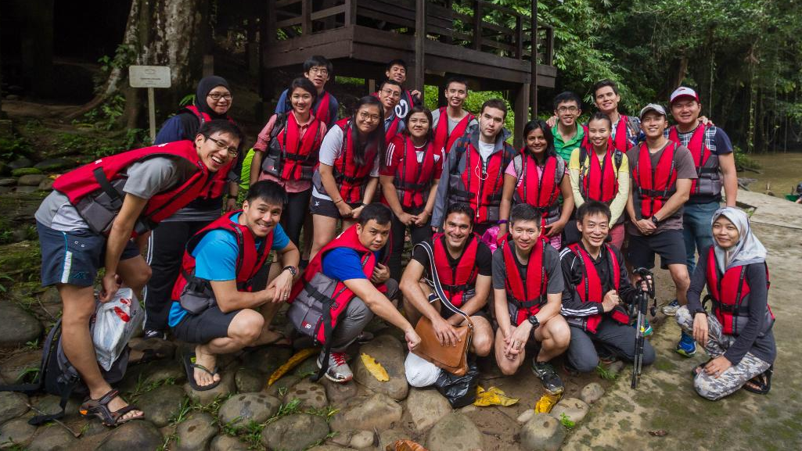

Slide 13
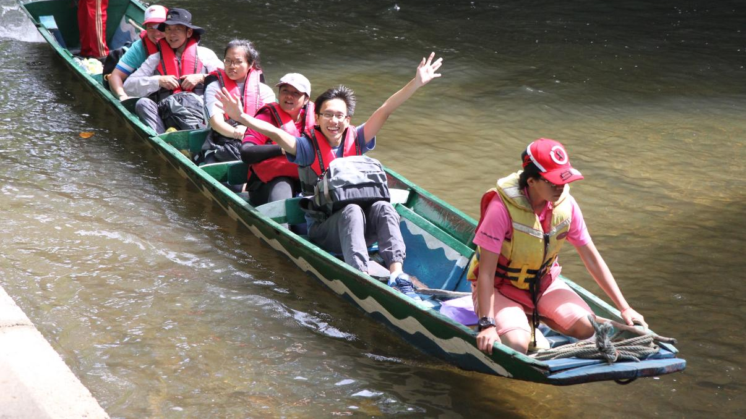

Slide 14
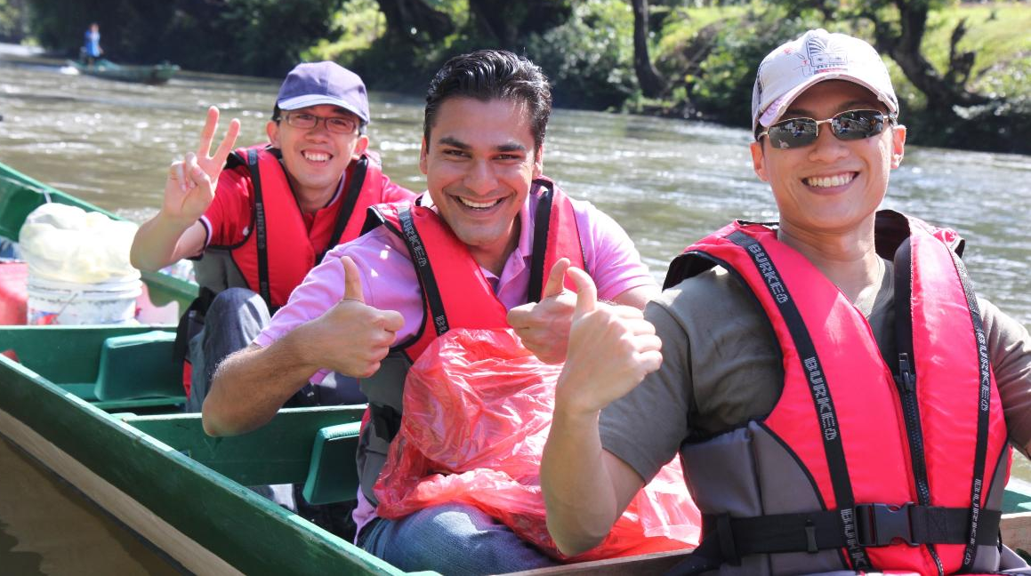

Slide 15
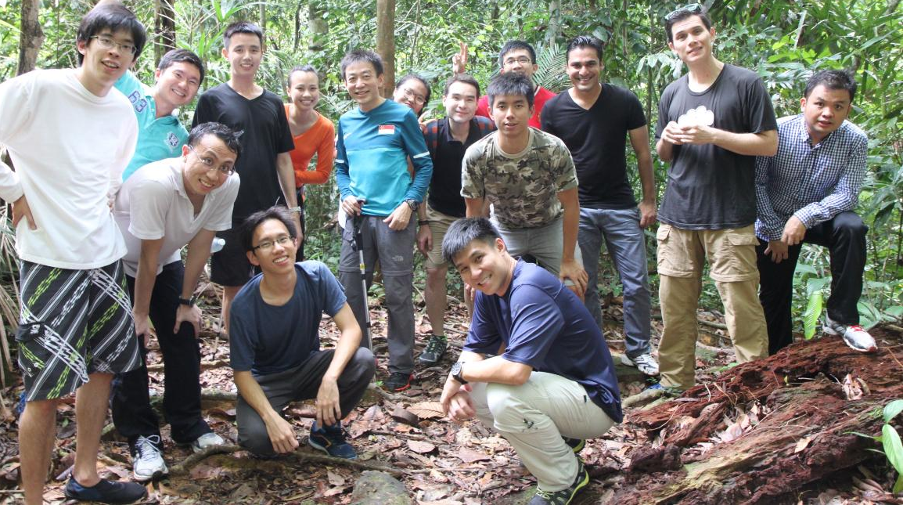

Slide 16
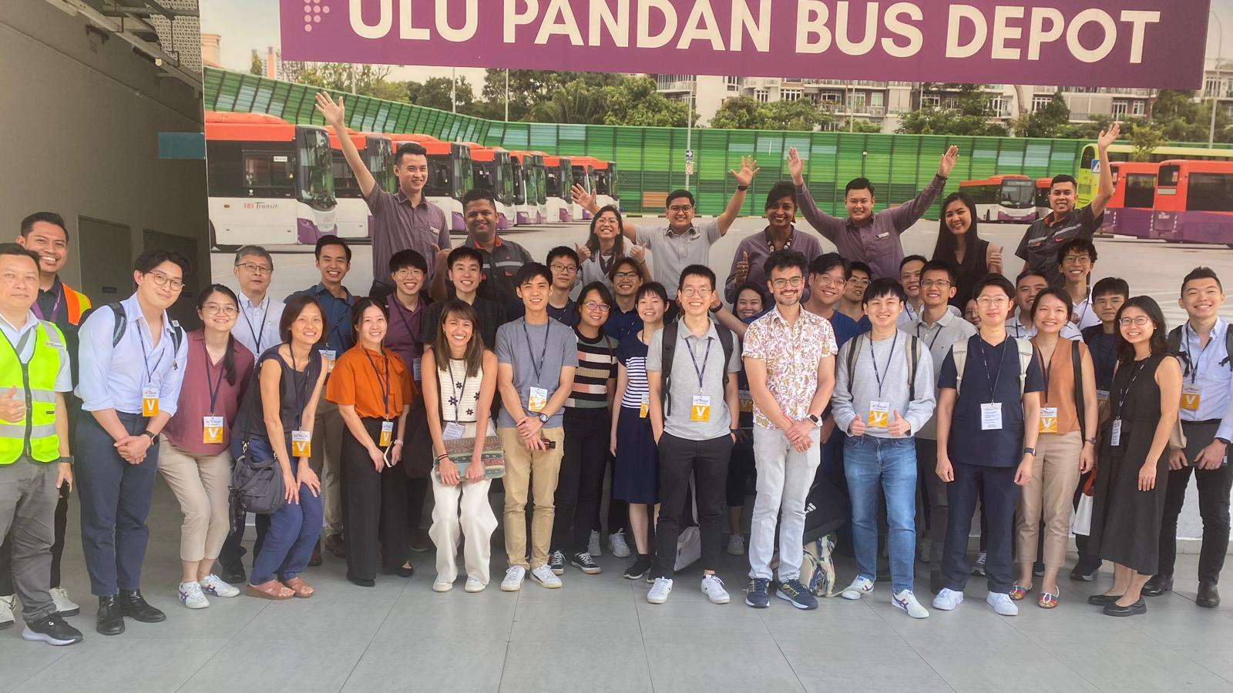

Slide 17
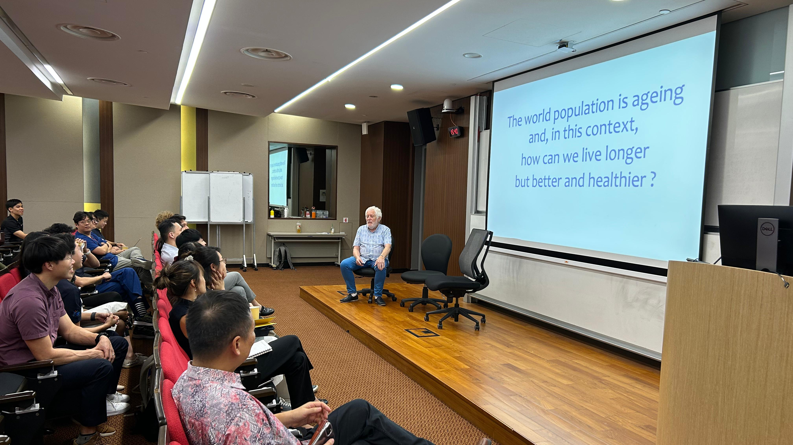

Slide 18
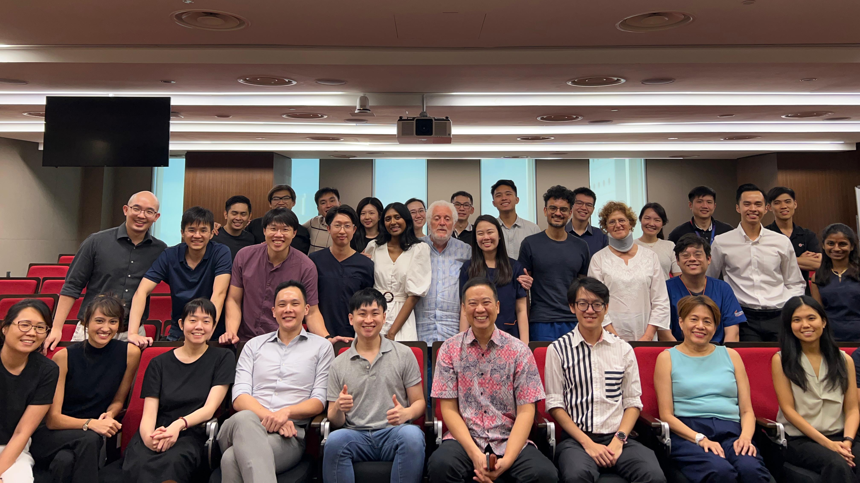

Slide 19
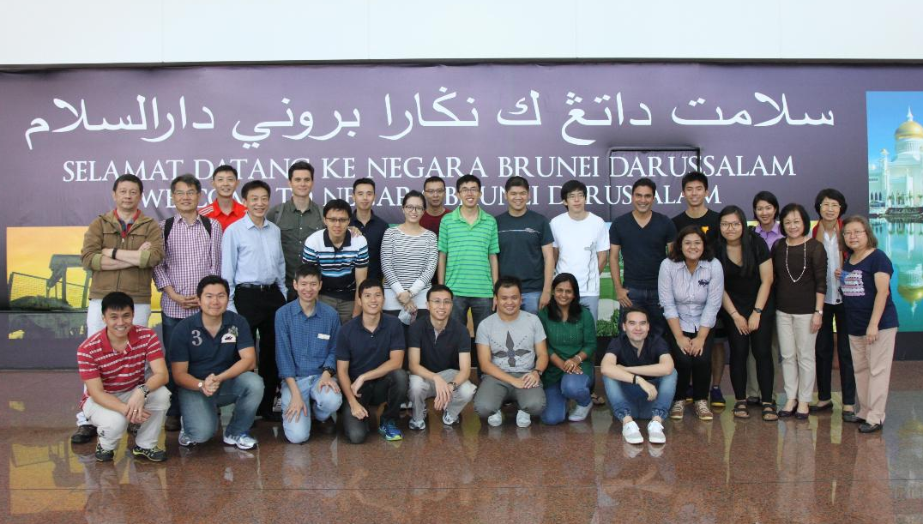

Slide 20
